Slide 1
MORPHOLOGY AND ULTRASTRUCTURE OF VIRUSES

Slide 2
INTRODUCTION
Viruses are obligatory parasitic infectious biological particles possessing only one type of nucleic acid and requiring the host cell’s mechanism to replicate.
They do not have a cellular organization and contain only one type of nucleic acid, either DNA or RNA but never both.
The study of viruses is called virology and it is one branch of microbiology.

Slide 3
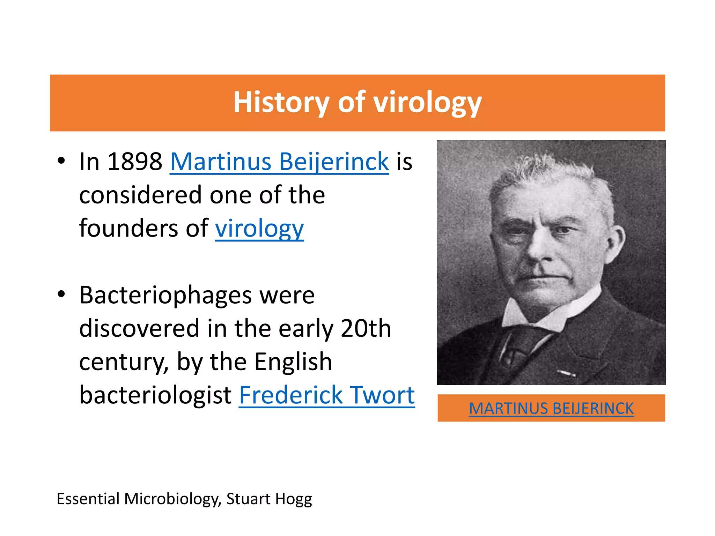

Slide 4
Tobacco mosaic virus (TMV) is the first discovered virus discovered by Martinus Beijerinck in 1898.
Since then, about 7000 types of viruses have been studied and well-described.

Slide 5
Habitat of Viruses
found in air, water, and soil, where cellular life form exists.
They are isolated from everywhere including polar ice to hot water vents or volcanic regions, deep oceans to rocks of deserts, acidic lakes to hyper alkaline and hypersaline salt lakes, etc.

Slide 6
Morphology of Viruses
Size
Structure, shape and symmetry:

Slide 7
Size of Viruses
Viruses are much smaller than bacteria.
The viruses range in size from 20 nm to 300 nm.
Poxviruses are one of the largest viruses and parvoviruses are one of the smallest viruses.

Slide 8
Structure of Viruses
Nucleic Acid (Viral Genome)
Capsid
Envelope

Slide 9
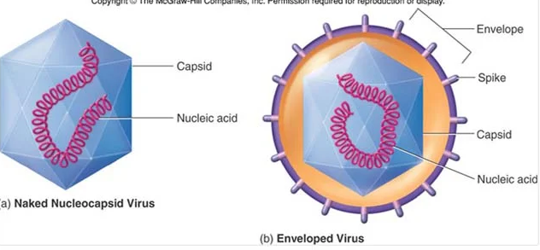

Slide 10
1.Nucleic Acid (Viral Genome)
A virion contains only one type of nucleic acid, either DNA or RNA, as its genome but never both.
The nucleic acid may be single-stranded or double-stranded.
Double-stranded RNA and single-stranded DNA are also found in many viruses.
Most viral genomes are within 7 to 20 kbp long;
The viral DNA may be linear or circular

Slide 11
A virion may contain a single RNA or several segments of RNA.
Positive sense RNA is known to have a 5’ to 3’ RNA genome and can be readily translated into proteins.
negative-sense RNA is known to have a 3’ to 5’ RNA genome that can’t be readily translated into proteins and needs to be transcribed to positive-sense RNA before translation.

Slide 12
2. Capsid:
The viral genomes are externally coated by a shell of proteins called capsid.
Capsid is a polymeric structure made of structural subunits called capsomers.
Capsid together with enclosed nucleic acid is termed as nucleocapsid.
Capsid protects the viral genome from any physical or chemical stresses, contains attachment sites to adhere to the host cell, and helps to penetrate the host cell.

Slide 13
3. Envelope
Some viruses are externally covered by a lipid bilayer membrane called an envelope.
Viral envelopes are derived from the host’s plasma membrane; hence, they are composed of lipid bilayers as in the plasma membrane.
virus-encoded virus-specific proteins (glycosylated membrane proteins), also called matrix proteins, are also found in the viral envelope.
membrane proteins are often demonstrated as viral spikes or knobs projecting outside the viral envelope.

Slide 14
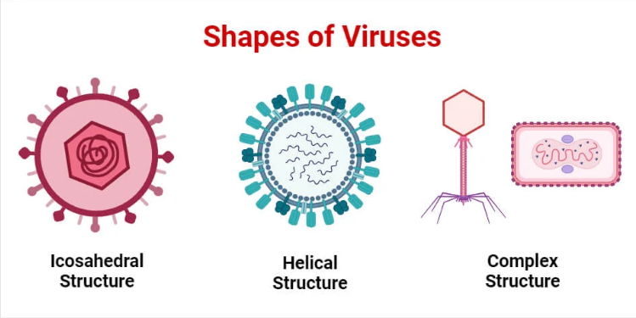

Slide 15
1. Icosahedral Structure
An icosahedron is a geometrical shape with 20 faces each in the shape of an equilateral triangle.
They nearly appear spherical in shape and initially.
Each triangular face is made of at least 3 capsomers, so at minimum 60 capsomers can form an icosahedron structure.
Examples: Adenovirus, and Herpes Simplex Virus.

Slide 16
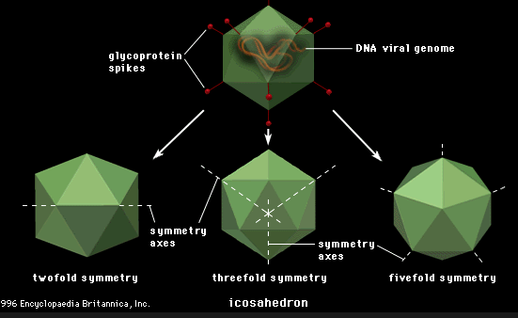

Slide 17
2. Helical Structure
It is a spiral shape in which capsid curves cylindrically around a central axis (nucleic acid core).
In helical viruses, the viral genome coils helically and the capsid proteins helically wind around the viral genome forming an elongated (tube/rod-like in structure) nucleocapsid.
Examples of helical viruses include Tobacco mosaic virus, influenza virus, measles virus, mumps virus, rabies virus, Ebola virus, etc.

Slide 18
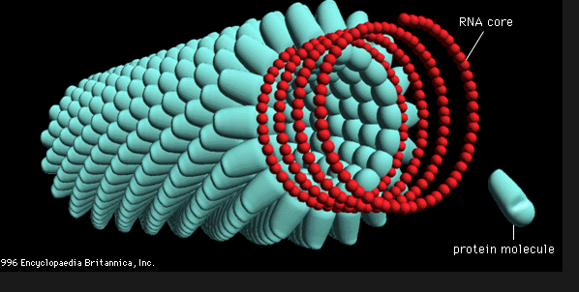

Slide 19
3. Complex Structure
Bacteriophages, poxviruses, geminiviruses, etc. show complex structures.
Many bacteriophages have icosahedral heads connected to cylindrical tail sheaths.

